Slide 1

Cluster Similar Papers

Slide 2
The goal
The goal of this projet is to create cluster of similar papers using unsupervised machine learning algorithm and to visualize the main words per each clusters

Slide 3
The data
Data from arXiv scientific papers datset.
The clusters are based only on the abstract text of the papers.

Slide 4
Pipeline
Create embeddings from the abstract text

Slide 5
Embeddings advantage
Embeddings allow us to capture the text semantic
Low text similarity with similar semantic will have similar embeddings
drink
Beer
algebra
mathematics

Slide 6
Pipeline
Create embeddings from the abstract text
Embedding dimensionality reduction

Slide 7
Dimensionality reduction
Decrease running time
Improve clusters quality

Slide 8
Pipeline
Create embeddings from the abstract text
Embedding dimensionality reduction
Get clusters with HDBSCAN

Slide 9
HDBSCAN clusters
Work well with embeddings
Possibility to get hierarchical clustering (we didn’t get but it’s possible)

Slide 10
Pipeline
Create embeddings from the abstract text
Embedding dimensionality reduction
Get clusters with HDBSCAN
Main cluster words Visualization

Slide 11
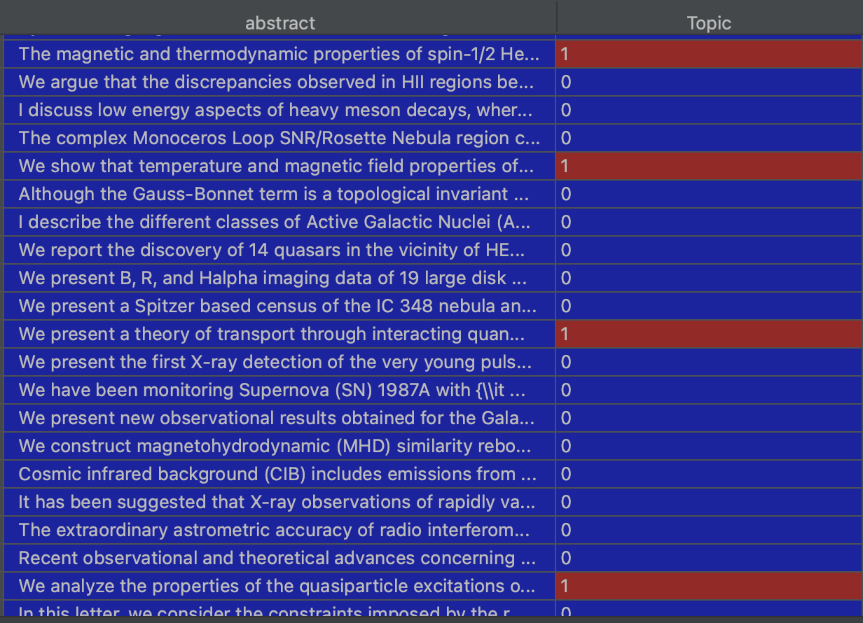
Get main words
For each abstract we assigned cluster

Slide 12
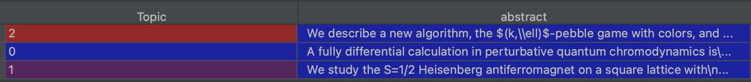
Get main words
Group by topics and join abstract text

Slide 13
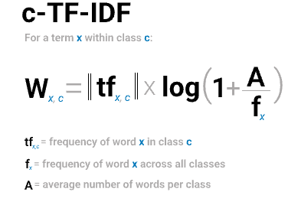
Get main words
Get c-TF-IDF score for each words of each topic
The top n words for each clusters will be the words with the n highest TF-IDF score

Slide 14
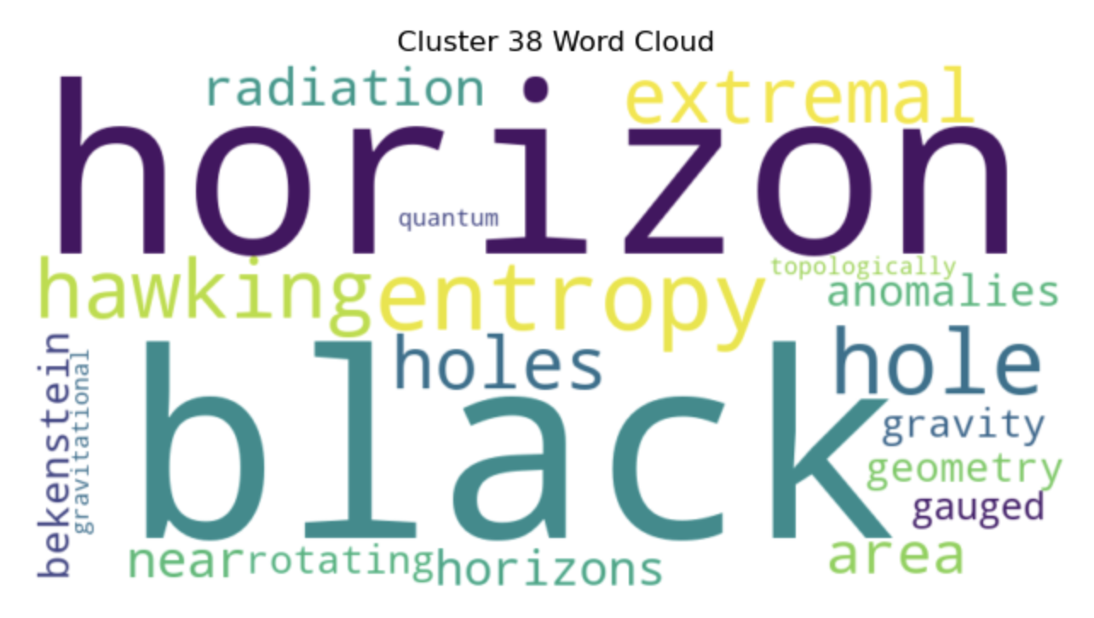
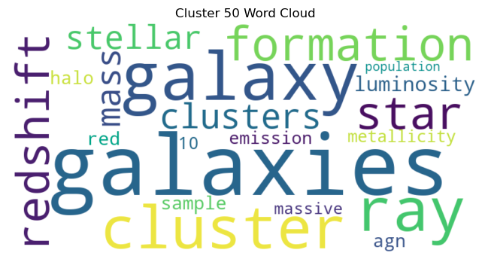
Word cloud visualization

Slide 15
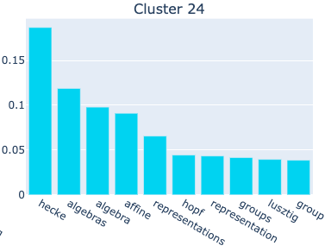
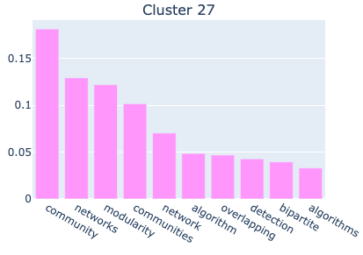
BaR Plot visualization

Slide 16
Summary
Create embeddings from the abstract text
Embedding dimensionality reduction
Get clusters with HDBSCAN
Main cluster words Visualization

Slide 17
Conclusion
Hard to have a good evaluation of our clustering
Clusters that looks very good and clusters that looks not good
Clusters on 100k papers because cluster issue
More data should improve the clusters quality
The scripts and visualization outputs are in the repository in the link https://github.com/ChelomoLubliner/ClusterSimilarPapers

